Slide 1
DATA ANALYSIS FOR SALARIES OF SAN FRANSICSO EMPLOYEES

Slide 2
AGENDA
OBJECTIVE
DATA OVERVIEW
ANALYSIS AND FINDINGS
SUMMARY

Slide 3
OBJECTIVE
The project aims to analyze employee compensation data , including Base Pay , Overtime Pay , Other Pay , Benefits , and their relation to Total Pay and Total Pay Benefits.

Slide 4
DATA OVERVIEW
This Dataset contains more than 300k employee records found in San Francisco from 2011 to 2018. Complete and accurate information is necessary to increase public understanding of government and help decision makers, including elected officials and voters, make informed decisions
Columns in the dataset:
● Employee Name: Name of the employee.
● Job Title: Title of the job.
● Base Pay: Base salary pay.
● Overtime Pay: Pay for overtime work.
● Other Pay: Any other types of compensation.
.
● Benefits: Benefits provided to the employee.
● Total Pay: The total pay without benefits.
● Total Pay Benefits: Total pay with benefits included.
● Year : The year of the payroll record

Slide 5
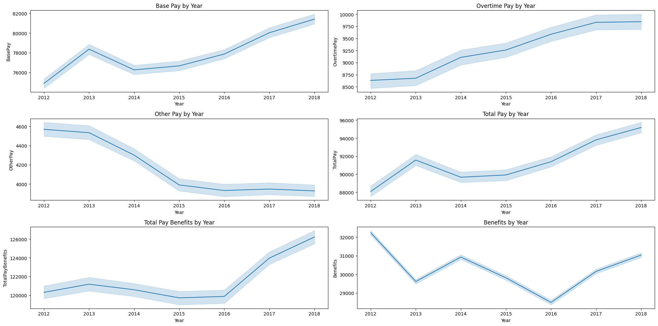
COMPENSATION OVER TIME
The records for the compensation we have from year 2012 to 2018
As from the findings, All the chart for each compensation type increases over the years ( except for otherpay & benefits chart ) .

Slide 6
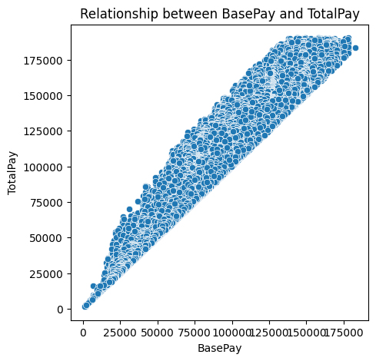
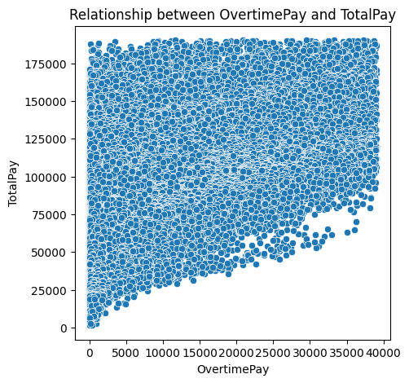
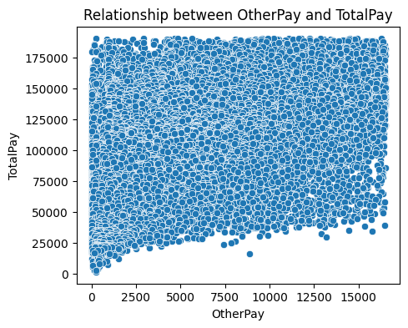
RELATIONSHIP BETWEEN EACH COMPENSATION TYPE AND TOTAL PAY
The plot between Overtime Pay & Total
Pay shows how extra earnings from over
time contribute to overall compensation.
The spread of points indicates that some
employees receive much higher Total Pay
due to significant overtime, while others
have low or no overtime.
The plot shows how additional
earnings (such as bonuses or allowances)
contribute to overall compensation.
The spread of points indicates that for
many employees, Other Pay is a small part
of Total Pay, while for some, it can
significantly increase their total earnings.
Increasing linear relation , also the
spread indicates that other compensation
like Overtime pay and other pay
significantly effect the Total Pay.
A positive correlation.

Slide 7
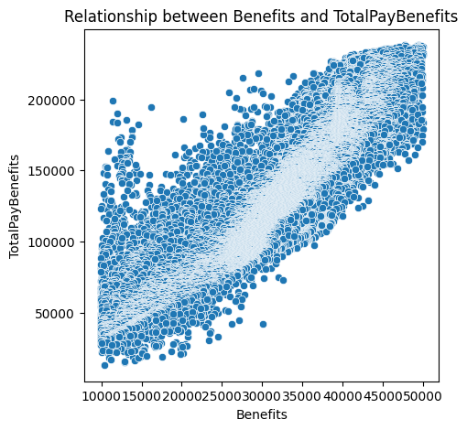
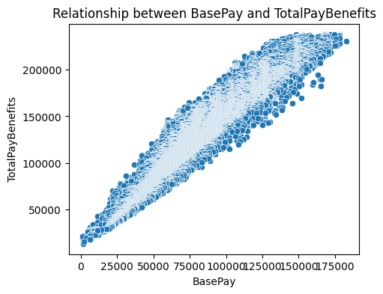
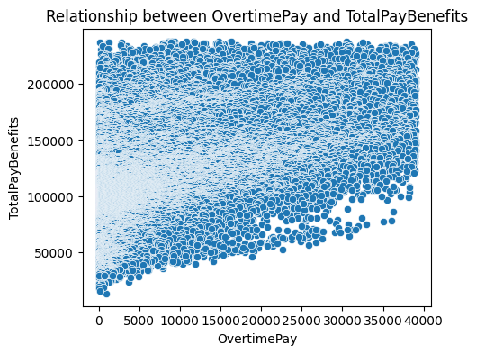
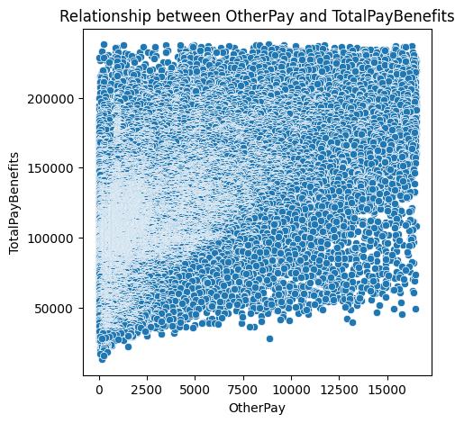
EACH COMPENSATION TYPE VS TOTAL PAY BENEFITS

Slide 8
THANK YOU

